Slide 1
Diagnostics and interventions to mitigate severe food insecurity due to pandemic
Christopher B. Barrett
Cornell University
June 19, 2020

Slide 2
This shock differs from 2008-11 or others
Less a supply shock to primary production (but could happen if movement restrictions last). Rather, a massive:
(i) demand shock disrupting livelihoods
(ii) food value chain shock through disruptions to (a) transport and (b) food service industries, both of which have disrupted prices/flows within distinct chains.
Underscores (i) importance of disequilibrium dynamics, and (ii) need high frequency sentinel sites (Barrett Science 2010; Headey & Barrett PNAS 2015).

Slide 3
A ready/scalable social safety net is key
Livelihoods have collapsed. Must replace these if can’t maintain employment (à la India’s NREGA).
Cash or in kind? Need to inform w/response analysis (e.g., MIFIRA, Barrett et al. Food Security 2009)
- When retail prices jump, in kind often favored over cash transfers - And if wholesale prices and freight rates fall, procurement (LRP or trans-oceanic) can help both consumers and farmers.
Either modality requires ready on-the-ground operational capacity.

Slide 4
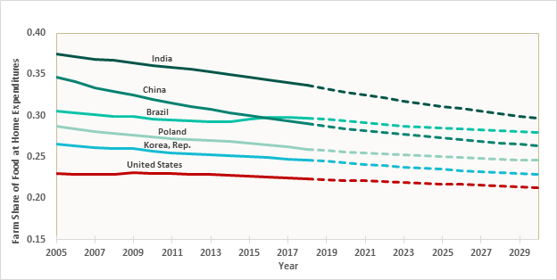
Pay attention to the value chain
Post-farmgate value chain accounts for 73% of FAH expenditures globally, 2015-15 (>90% of FAFH).
Ying et al. in review
Must track prices at high spatio-temporal resolution & @ different stages in value chains to ID bottlenecks. Disruptions can cause producer/consumer prices
to diverge sharply. Must monitor both.

